Slide 1

Real-World Applications of Computer Vision
ITA0506- COMPUTER VISION
Guided By: Dr. Jeni Gracia
Presented by: HARSHITHA GS
Reg No:192421221

Slide 2
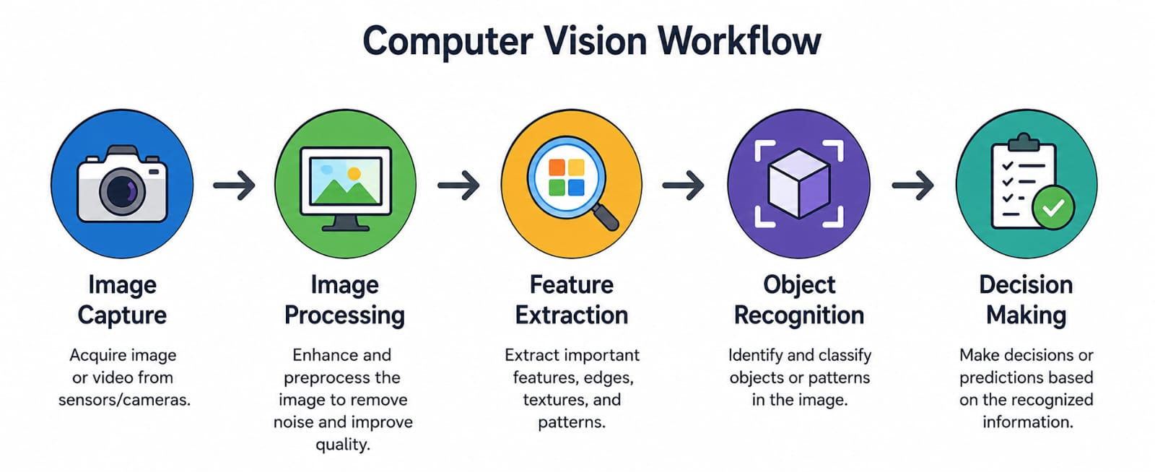
Introduction to Computer Vision
Computer Vision is a branch of Artificial Intelligence (AI) that enables computers to capture, process, analyze and interpret images or videos, allowing them to understand and make decisions based on visual information.
Objectives:
Image understanding
Object detection
Face recognition

Slide 3
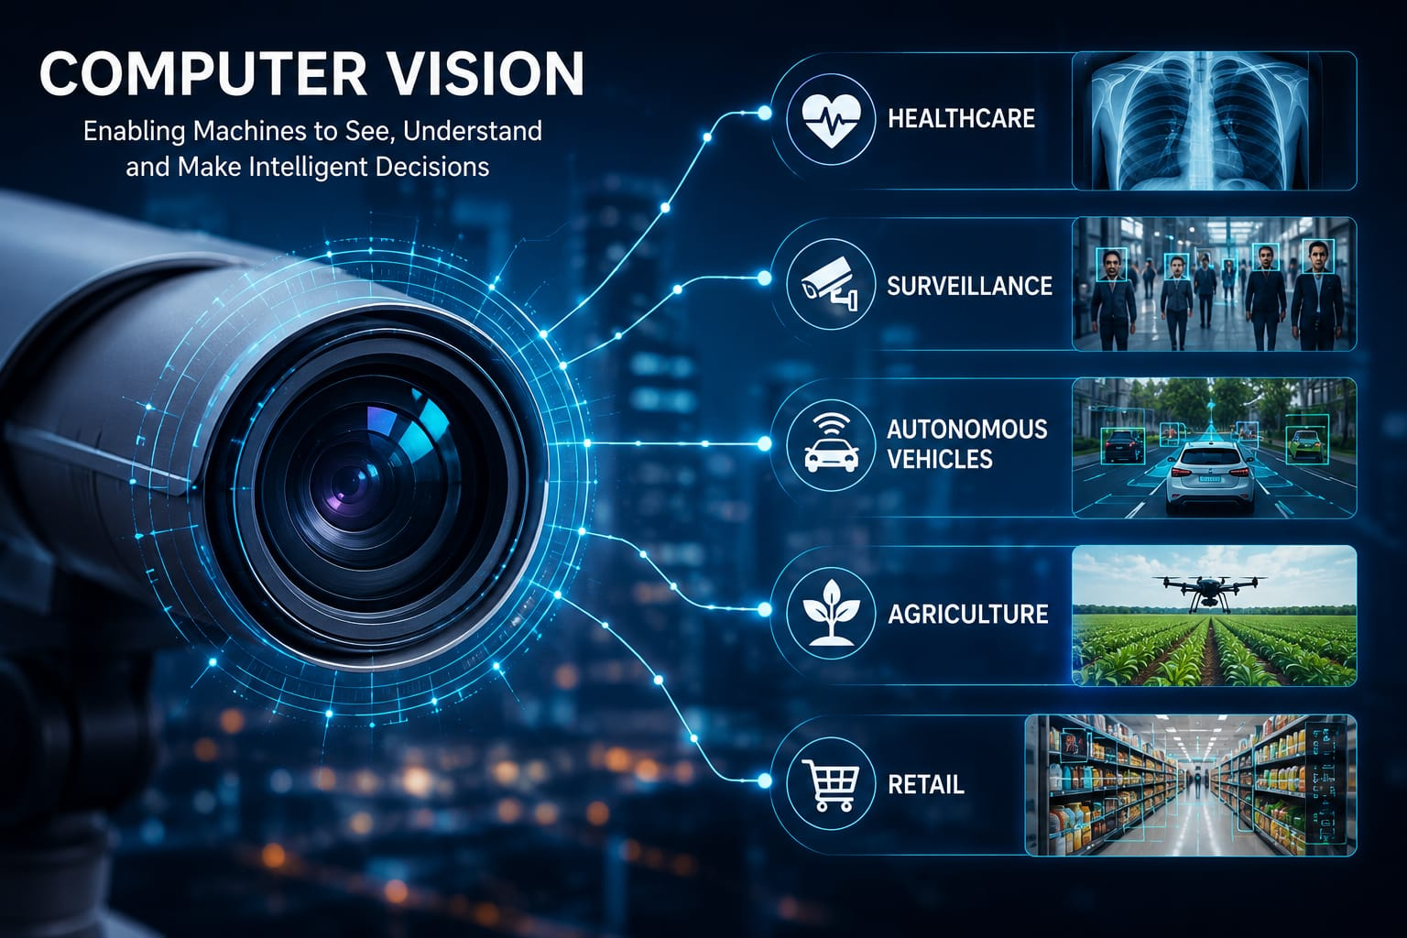
Applications in Healthcare and Surveillance
Healthcare
Disease detection from X-rays, CT scans, and MRI images
Medical image analysis
Patient monitoring
Surgical assistance
Surveillance
Face recognition
Smart CCTV monitoring
Traffic monitoring
Intruder detection

Slide 4
Applications in Autonomous Vehicles and Agriculture
Autonomous Vehicles
Lane detection
Traffic sign recognition
Pedestrian detection
Collision avoidance
Agriculture
Crop disease detection
Weed identification
Drone-based field monitoring
Fruit quality inspection

Slide 5
Applications in Retail
Retail
Automated checkout systems
Inventory management
Shelf monitoring Customer behaviour analysis
Product identification
Benefits
Faster shopping experience
Better inventory tracking
Improved customer satisfaction

Slide 6
Challenges and Future Scope
Challenges
Poor lighting conditions
Image noise
Occlusion Privacy concerns
High computational requirements
Future Scope
AI-powered healthcare
Smart cities
Advanced robotics
Precision agriculture
Intelligent transportation
Fully automated retail systems

Slide 7
Conclusion
Computer Vision enables machines to understand visual information and make intelligent decisions.
It is widely used in healthcare, surveillance, autonomous vehicles, agriculture, and retail.
The technology improves automation, accuracy, and efficiency across industries.
As AI continues to advance, Computer Vision will play an even greater role in solving real-world challenges.

